Slide 1
Kalman Filters
Application in non-linear systems
Aakash Goel
2019MT10668

Slide 2
Linear Kalman Filter
Kalman Filter is an optimal state observer
Also called Linear Quadratic Estimation (LQE)
Works for linear systems
Takes into account statistical noise
Combines estimated and measured readings from different sources using joint probability distribution to estimate an optimal reading
Process noise (w_{k}): Noise due to inexact nature of modelled physical equations, such as deviations due to air pressure. Needs to be tuned.
Measurement noise (v_{k}): Noise characteristic to the sensor's working. Needs to be obtained from sensor calibration.
Both w_{k} and v_{k} can be assumed to be mutually uncorrelated white Gaussian noise processes.

Slide 3

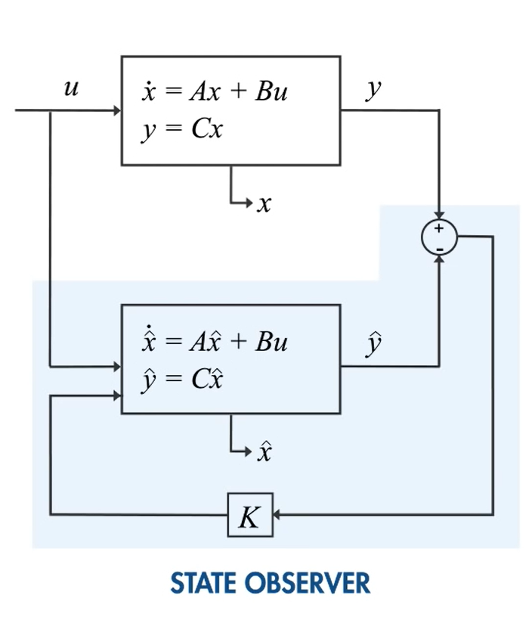
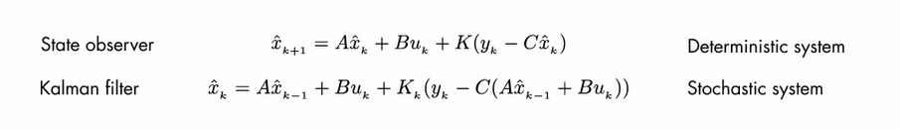
The state-space equations of the system are:
In control theory, a state observer or state estimator is a system that provides an estimate of the internal state of a given real system, from measurements of the input and output of the real system.

Slide 4
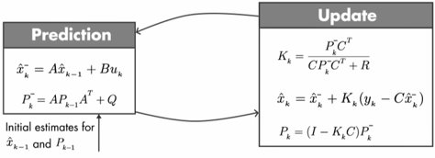
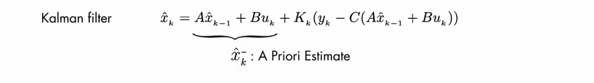
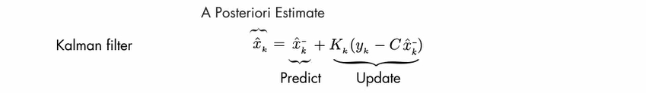
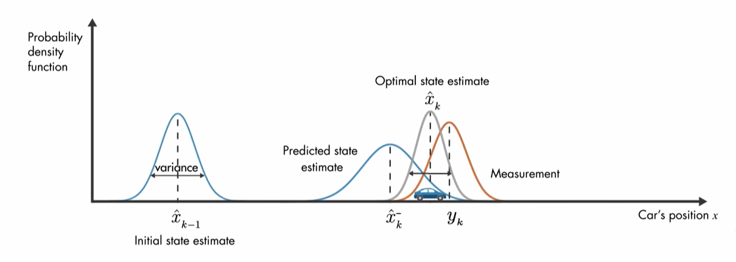
In essence, Kalman filter has two steps: Predict and Update

Slide 5
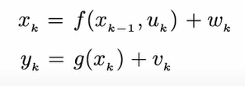
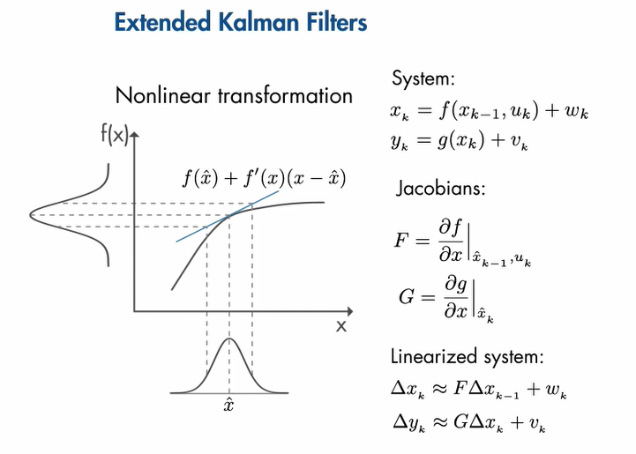
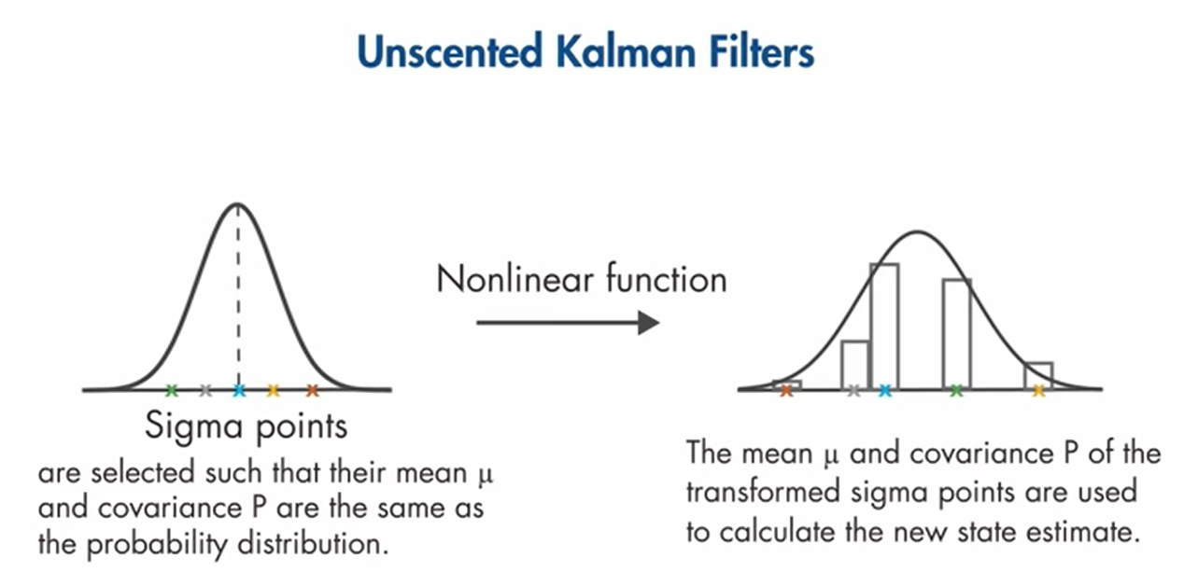
Non-linear systems

Slide 6
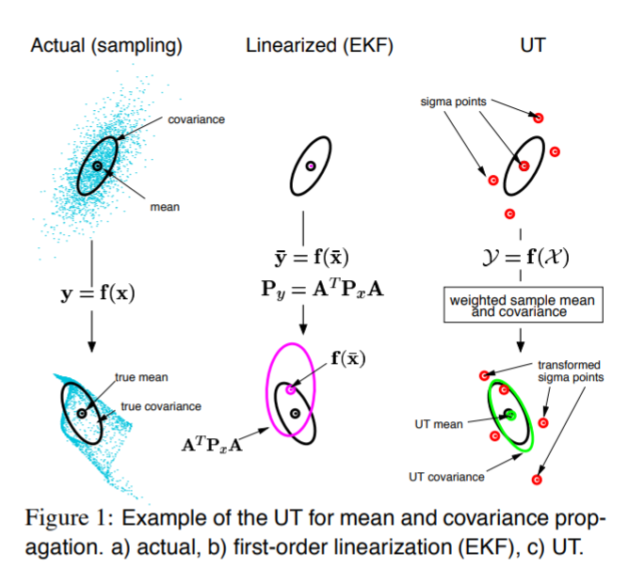
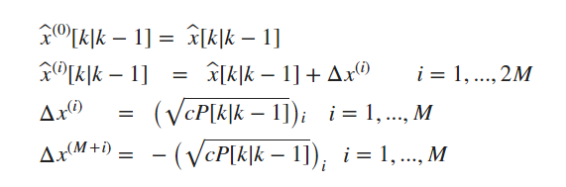
Sigma points

Slide 7
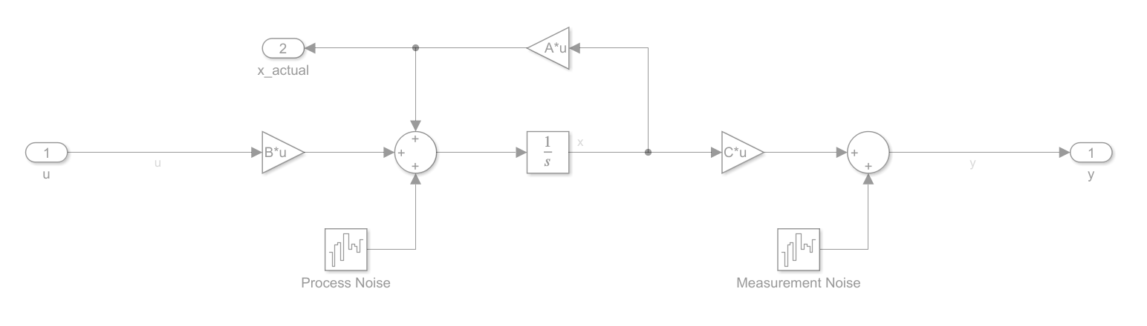
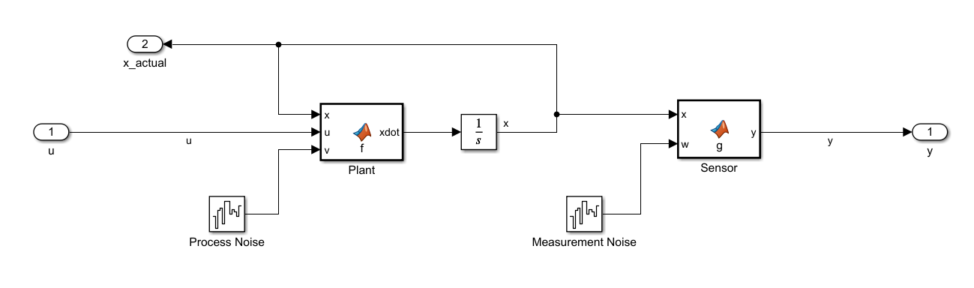
Modelling
Linear model
Non-linear model

Slide 8
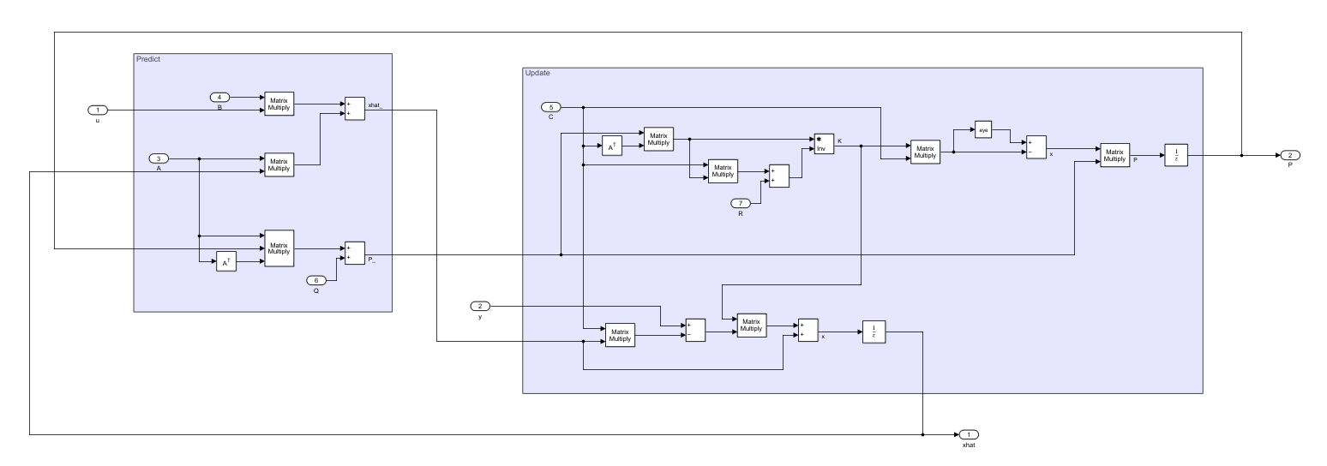
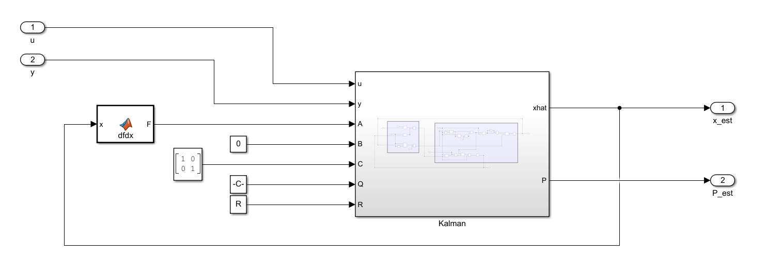

Slide 9
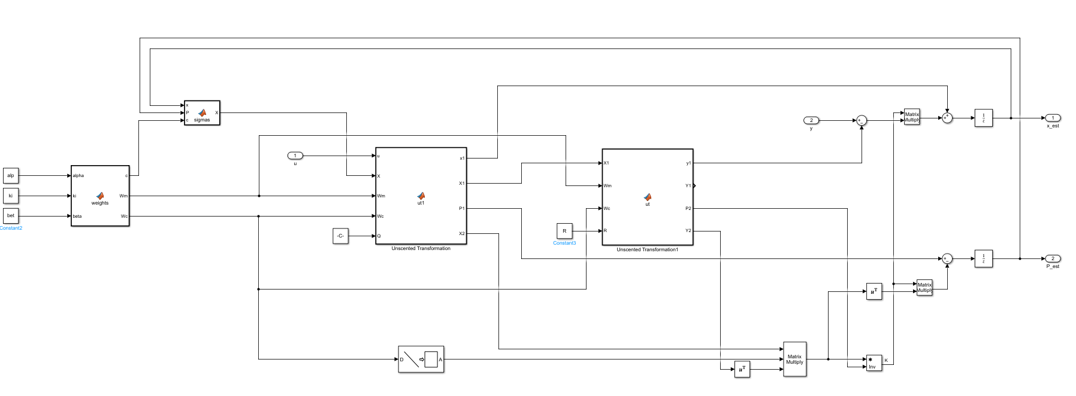

Slide 10
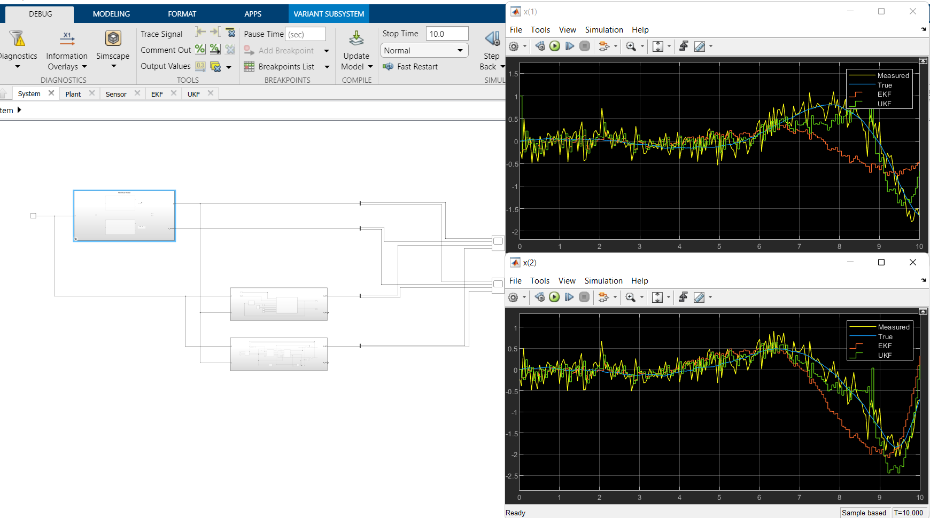

Slide 11
Follow up
Tuning of kalman filter parameters and initial state assumptions
Normalized error visualization
Implementation of particle filter for non-gaussian system
Model a real system and compare results with actual hardware testing

Slide 12
Applications in electronics
Battery pack state of charge estimation using ESC cell model
Sensorless motor drive control and state estimation
Automotive navigation systems and sensor fusion
Image processing and noise removal

Slide 13
References
https://in.mathworks.com/help/control/ug/extended-and-unscented-kalman-filter-algorithms-for-online-state-estimation.html
https://groups.seas.harvard.edu/courses/cs281/papers/unscented.pdf
https://in.mathworks.com/help/control/ug/nonlinear-state-estimation-using-unscented-kalman-filter.html
https://academic.csuohio.edu/simond/pubs/ESDNonlinear.pdf
https://ieeexplore.ieee.org/document/7530343
https://ieeexplore.ieee.org/document/7734116

